Slide 1
Variational Quantum Classifier
By Annapurna Ramesh

Slide 2
Introduction
Classification approach we design a variational algorithm which exploits the large dimensional Hilbert space of our quantum processor to find an optimal cutting hyperplane in a similar to Support Vector Machines(SVM).
The algorithm consists of two main parts: a training stage and a classification stage.
Training stage, a set of labeled data points are provided, on which the algorithm is performed.
Classification stage, we take a different set of data points and run the optimized classifying circuit on them without any label input.
Then we compare the label of each data point to the output of the classifier to obtain a success ratio for the data set.

Slide 3
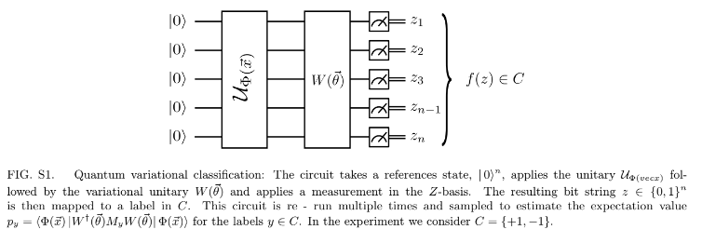
Methodology
For both the training and the classification stages, the quantum circuit that implements the algorithm comprises three main parts: the encoding of the feature map(Data Embedding), the variational optimization and the measurement,
Fig S1. The training phase consists of these steps.

Slide 4
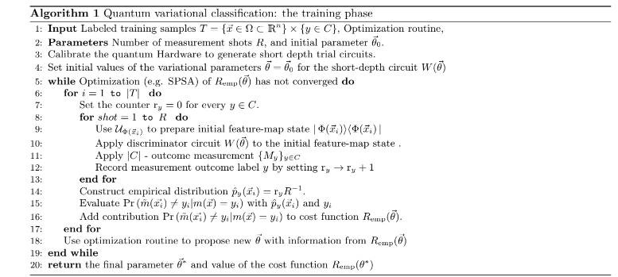
Algorithm

Slide 5
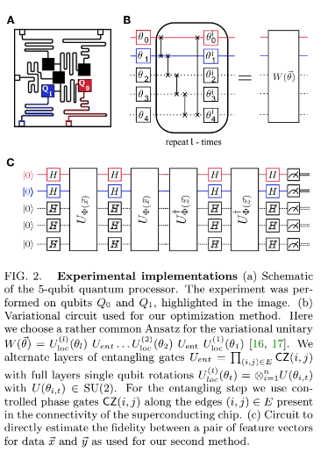
Circuit diagram

Slide 6
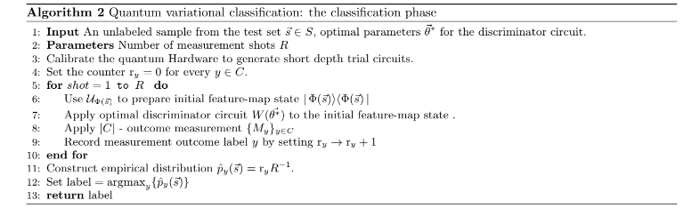
Algorithm
The classification can be applied when the training phase is complete. The optimal parameters are used to decide the correct label for new input data. Again, the same circuit is applied as in Fig S1, however, this time the parameters are fixed and the outcomes are combined to determine the label which is reported as output of the classifier.

Slide 7
Conclusion/References
Supervised learning with quantum enhanced feature spaces Vojtech Havlicek, Antonio D. C ́orcoles , Kristan Temme, Aram W. Harrow, Abhinav Kandala, Jerry M. Chow , and Jay M. Gambetta IBM T.J. Watson Research Center, Yorktown Heights, NY 10598, USA and Center for Theoretical Physics, Massachusetts Institute of Technology, USA (Dated: June 7, 2018)

